Slide 1
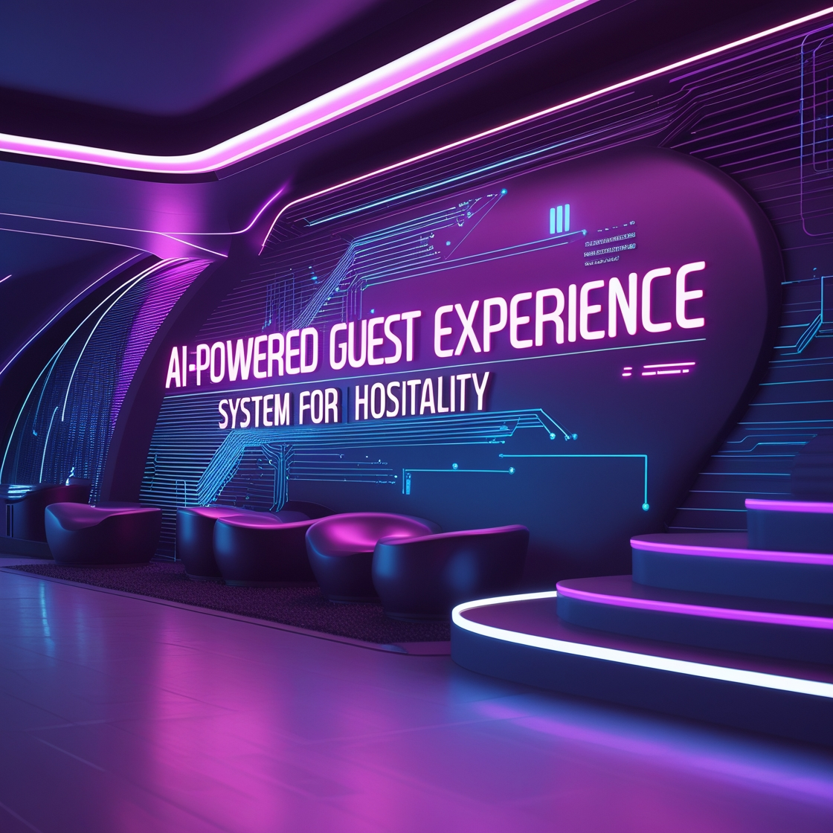
AI-Powered Guest Experience Personalization System for Hospitality
Transforming hospitality with AI-driven personalization. Elevating guest satisfaction through dynamic recommendations and real-time feedback analysis. Ensuring proactive service optimization and seamless issue resolution. Enhancing guest loyalty with data-driven insights and personalized experiences.

Slide 2
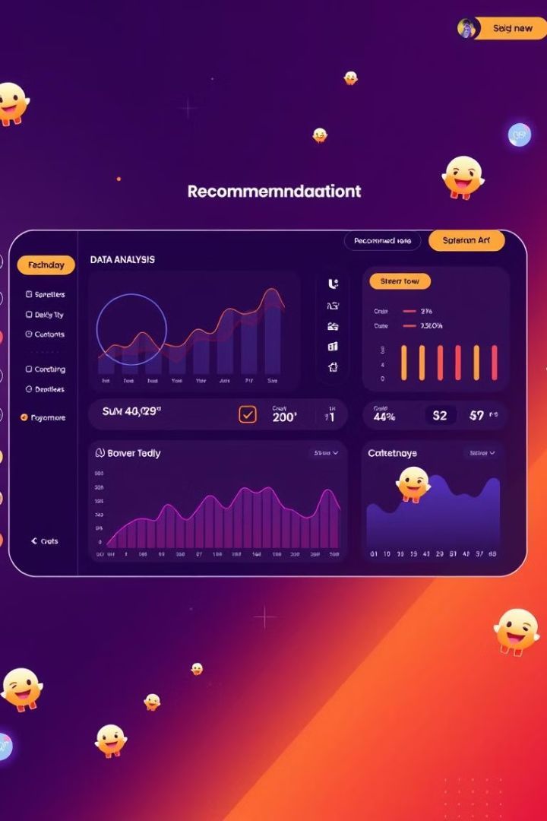
Objectives
1
Personalized Recommendations
Tailored dining, activities, and amenities. Driven by guest behavior analysis.
2
Real-Time Sentiment Monitoring
Proactive addressing of guest feedback. Ensures immediate action.
3
Increased Guest Satisfaction
Dynamic personalization enhances experience. Achieves elevated satisfaction.
4
Automated Alerts
Staff receive alerts for issue resolution. Optimizes service delivery.

Slide 3
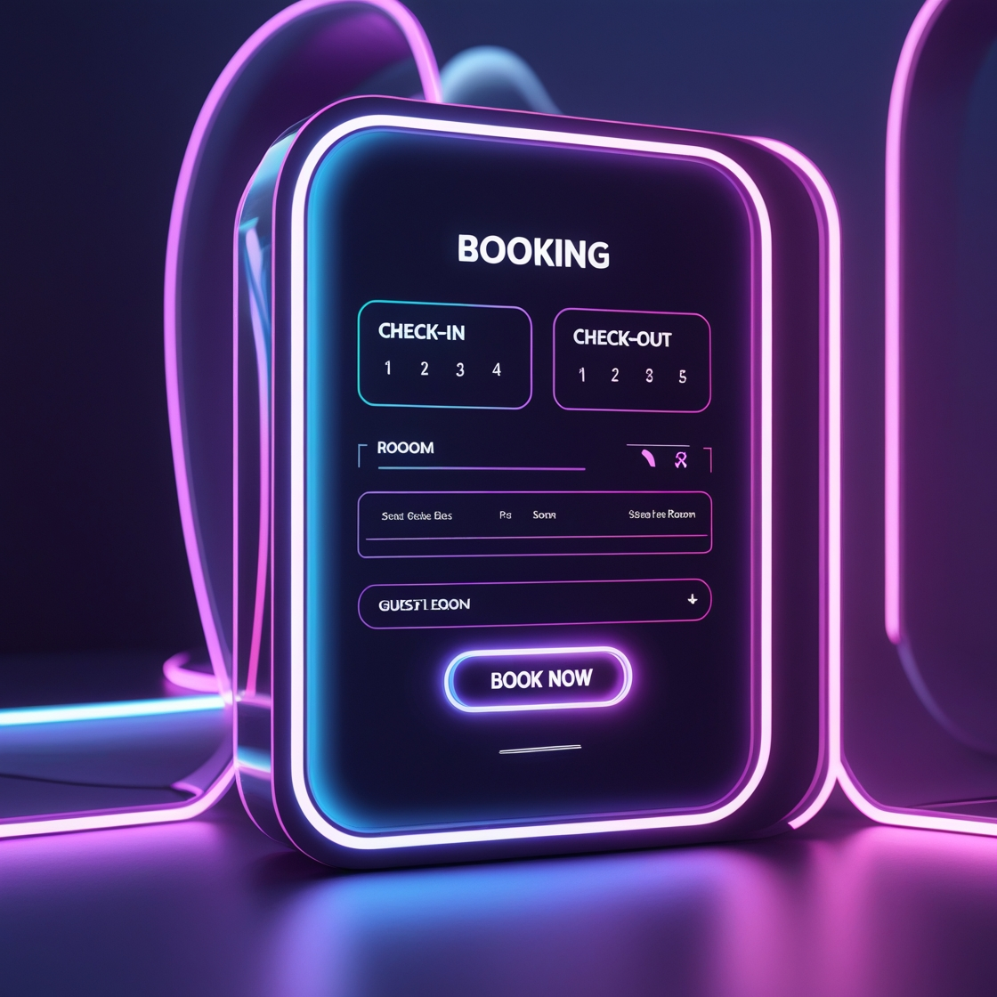
Personalized Guest Experience: Smart Recommendations
Personalized Recommendations: Enhancing guest experience with tailored amenity and activity suggestions.
Dynamic Booking Interface: Adapts in real-time based on user preferences and behavior.
Hybrid Filtering Approach: Combines user-based and item-based filtering for accurate predictions.
Automated Email Alerts: Coupon codes, recommended dishes, and offers are sent directly via email.

Slide 4



🍽️ Personalized Dish Recommendations & Discounts
Enhance guest experience with AI-powered dining suggestions! Our system personalizes dish recommendations based on individual preferences, stay details, and past dining behavior, all while offering exclusive discounts.
Customer Data Processing
Model Prediction (XGBoost)
Personalized Recommendations
We analyze inputs such as age (e.g., 25-35), cuisine preference (e.g., North , South, Multi), stay duration (e.g., 3 days, 7 days), and past dining behavior to understand your unique tastes.
Our XGBoost algorithm assigns probability scores to various dishes based on data analysis. The system generates "Probability Scores" (e.g., Dish A: 92%, Dish B: 88%, Dish C: 85%) to identify the best options.
Discover top 3 dishes tailored to your preferences, along with a certain amount of discount on each. Examples include: South Indian Cuisine (Idly, Dosa, Sambar), North Cuisine (Roti, Dal, Thali), or Multi (Steak, Noodles, Salad).

Slide 5
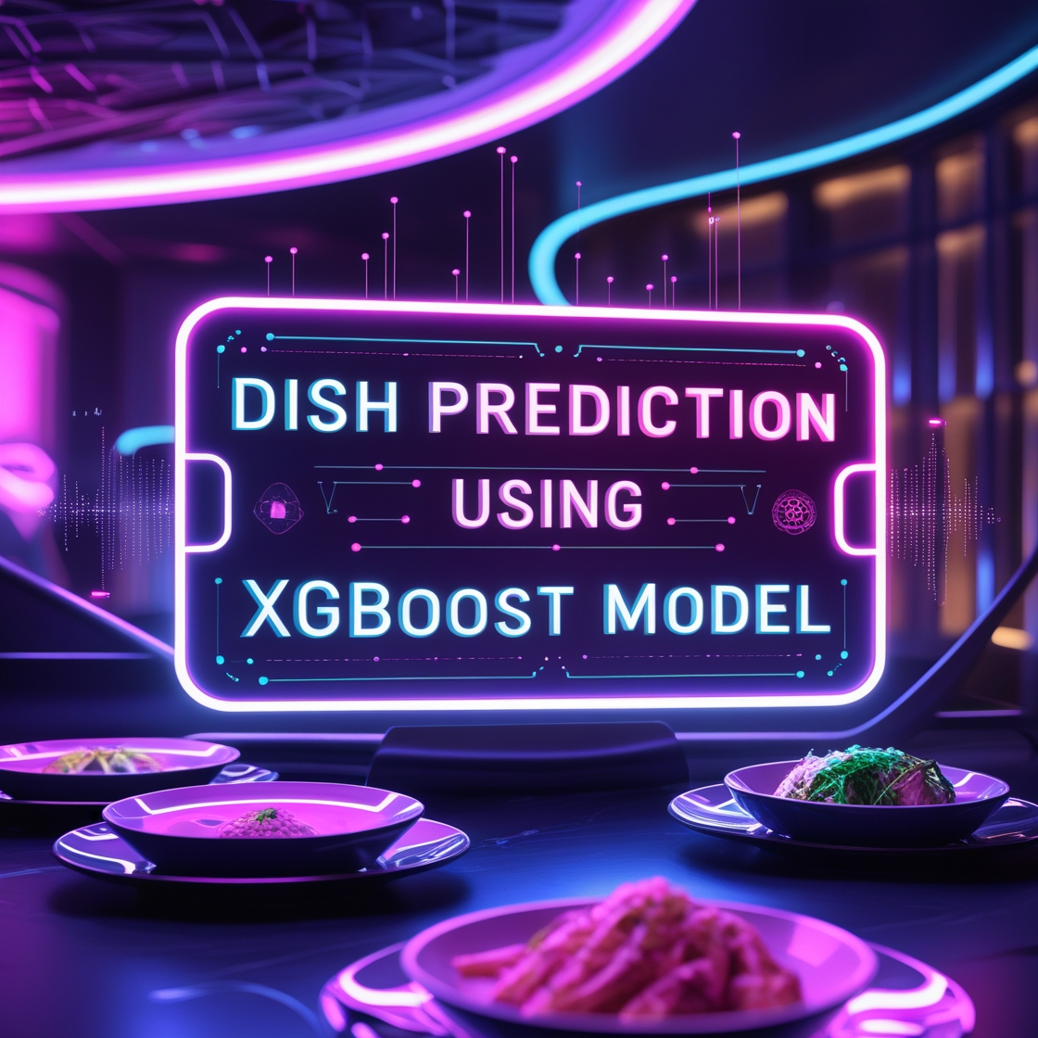
XGBoost for Favorite Dish Prediction
Why XGBoost?
Efficient & Robust for Imbalanced Data: Handles imbalanced datasets in guest dining preferences .
Handling Imbalance: Since our dataset is having allot of null values, XGBoost handles them better.
Performance vs. Random Forest: Faster training, scalable, with L1/L2 regularization to prevent overfitting.
Future Enhancements: Despite 0.18 accuracy, trends are valuable. hybrid models can improve predictions.

Slide 6
Feature Engineering: Transforming Raw Data
Feature engineering transforms raw data. It creates features for predictive models. This improves model accuracy.
Customer Behavior & Recency
Cuisine Preferences &
Dishes Preferred
Age-Based Segmentation
Loyalty & Stay Duration
Tracks order frequency. Allows targeted promotions.
Matches dishes to favorite cuisines. Increases successful recommendations.
Personalizes recommendations for age groups. Caters to different tastes.
Identifies returning customers. Provides special offers.
Benefit: Improved model performance.

Slide 7
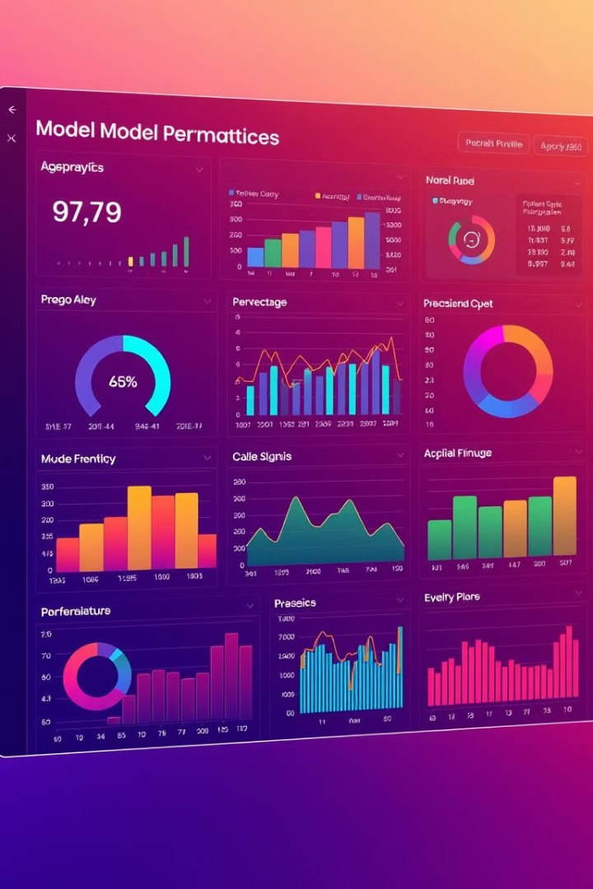
Model Evaluation & Significance
18.76
2.7x
Accuracy
Better
Achieved model accuracy
Vs. random chance
15
Classes
Distinct Dish Choices
Our model’s 18.76 accuracy is 2.7x better than random chance. This demonstrates significant predictive capability. Even with high dimensionality and guest variability, 0.18 accuracy allows targeted recommendations. This improves customer satisfaction and sales.

Slide 8
Retrieval-Augmented Generation (RAG)
Definition
How It Works
Application
RAG combines retrieval with generation. It provides accurate, context-aware responses. RAG summarizes and extracts insights from hotel reviews.
Retrieval Phase: Searches reviews for relevant information.
Extracts guest sentiments from reviews.
Generation Phase: AI generates responses based on retrieved data.
Generates insights on quality and experience.
Personalizes recommendations for guests.

Slide 9







RAG (Retrieval-Augmented Generation) System Workflow for Guest Review Analysis
Collect Guest Reviews
Gather data from sources from User review submissions.
Convert to Embeddings
Transform reviews into numerical vectors. Use TogetherEmbeddings.
Store in Pinecone DB (Vector DB)
Index embeddings in Pinecone for fast search. Cloud-native vector database.
Query for Relevant Reviews
Formulate queries with keywords and filters. Converts text into numerical vectors for better AI comprehension
Retrieve Top Reviews
Fetch relevant reviews based on similarity scores.
Summarize Using LLM Model (Together.ai)
Generate concise summaries of the retrieved reviews.
Output Insights & Recommendations
Present key insights and recommendations.

Slide 10
Guest Experience Insights: Integrated Dashboards
Objective: Empowers managers with real-time analytics that boost guest experience, drive operational excellence, and unlock business growth.
Guest Feedback Command Center
Hotel Booking Insights
Dining Intelligence Center
Reveals guest booking patterns by cuisine preference, helping managers create targeted offerings and optimize marketing strategies to increase revenue and guest satisfaction.
Provides real-time data on dining behaviors and preferences, enabling better staffing, menu planning, and service delivery to enhance restaurant performance and guest experience.
Identifies key service strengths and improvement areas from guest reviews, allowing managers to address issues quickly and replicate successful practices across operations.

Slide 11
Thank You

